Slide 1
Samsung Generative AI Hackathon-Voice Technology
BY
Aryan S Pillai
Suyash Aggarwal
Rahul Aggarwal

Slide 2
INTRODUCTION
In today's fast-paced world, efficient customer service is crucial for business success. Our project addresses this need by leveraging AI technology to analyze customer service calls. By providing personalized solutions, automating tasks, and enhancing agent performance, our tool aims to revolutionize the customer service landscape.

Slide 3
Problem Statement
Challenges in traditional customer service:
Inadequate agent training
Ineffective problem resolution
Inefficient call handling
Decreased customer satisfaction

Slide 4
Existing limitations:
Lack of comprehensive tools
Inadequate integration with communication platforms
Hindrance to analyzing customer interactions
Pressing need for:
Sophisticated voice technology tool
Enhanced agent performance
Improved customer satisfaction
Streamlined customer interactions in the service industry

Slide 5

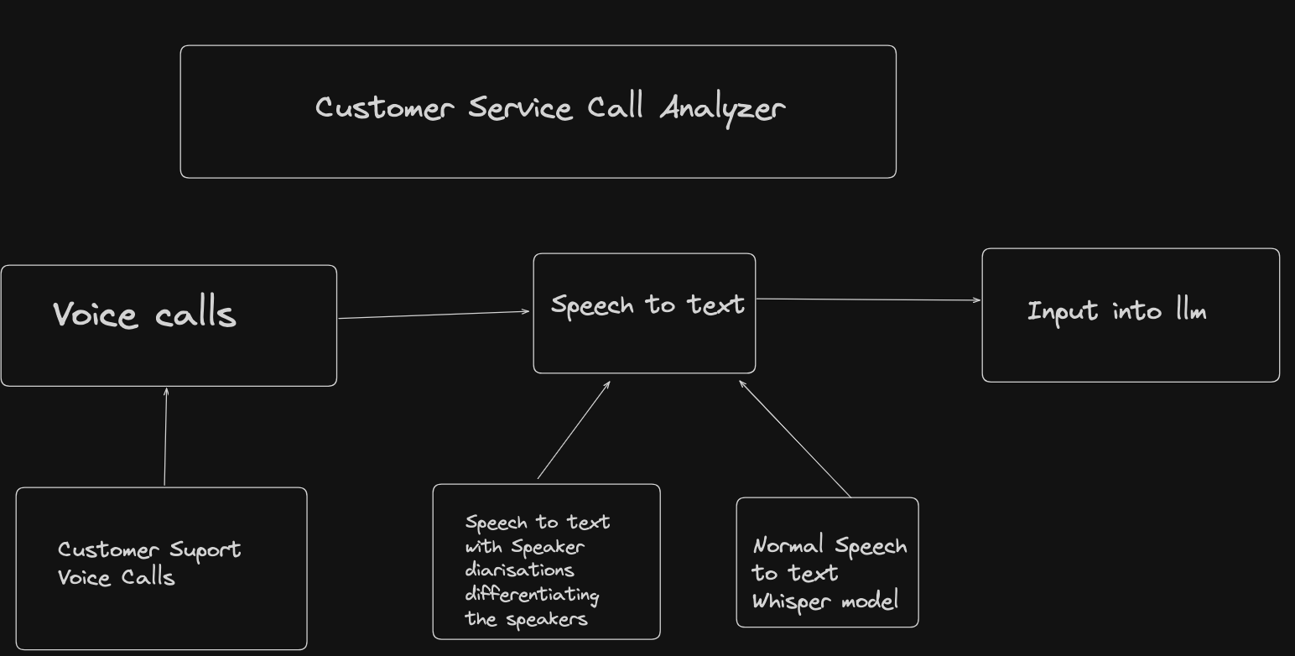
System architecture

Slide 6
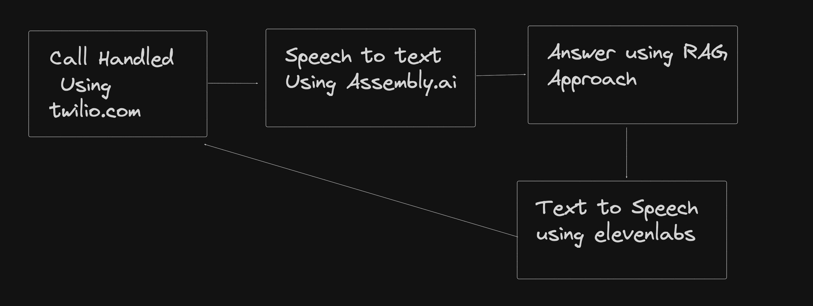
How the Call is Handled

Slide 7
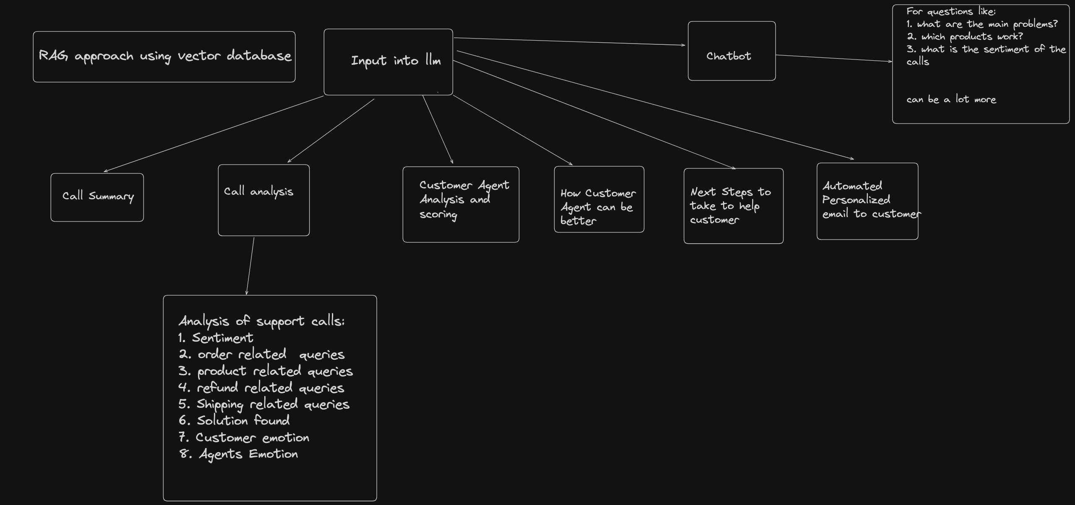
Flow Diagram

Slide 8
CODE DEMO

Slide 9
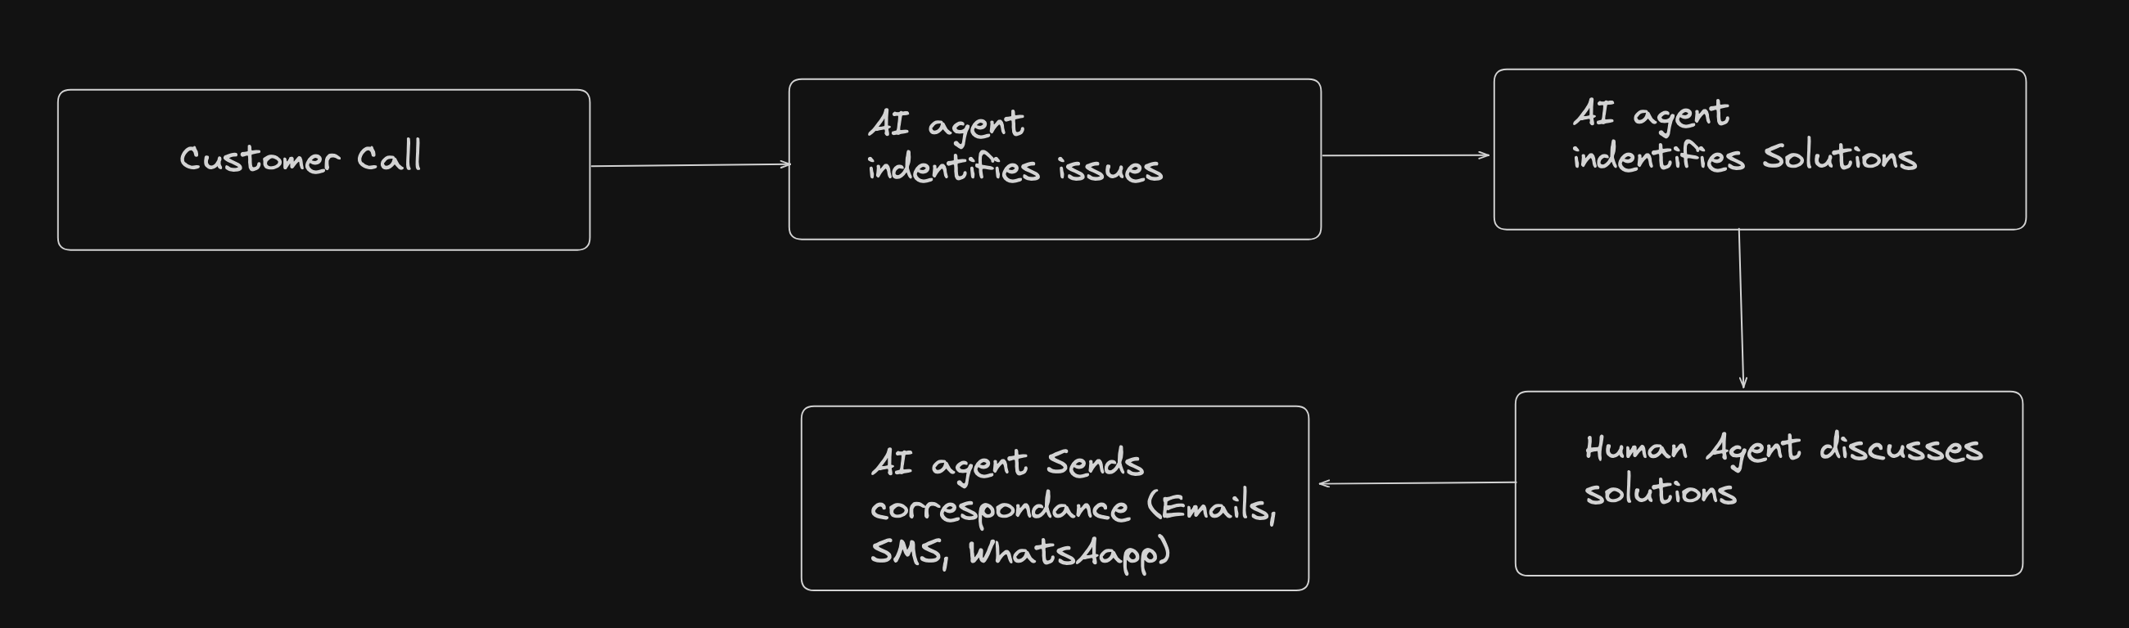
Proposed Solution For Further Development

